Slide 1

Consuming Data with F# Type Providers
TYPE ALL THE DATA
@rachelreese | rachelree.se | github.com/rachelreese
@JetTechnology | techgroup.jet.com
Notes:
Jet is awesome.
Jet is hiring.
Jet is all F#.
NY F# user group is very vibrant
Starting up labs once a month
Starting classes.

Slide 2
What is Jet.com?

Slide 3
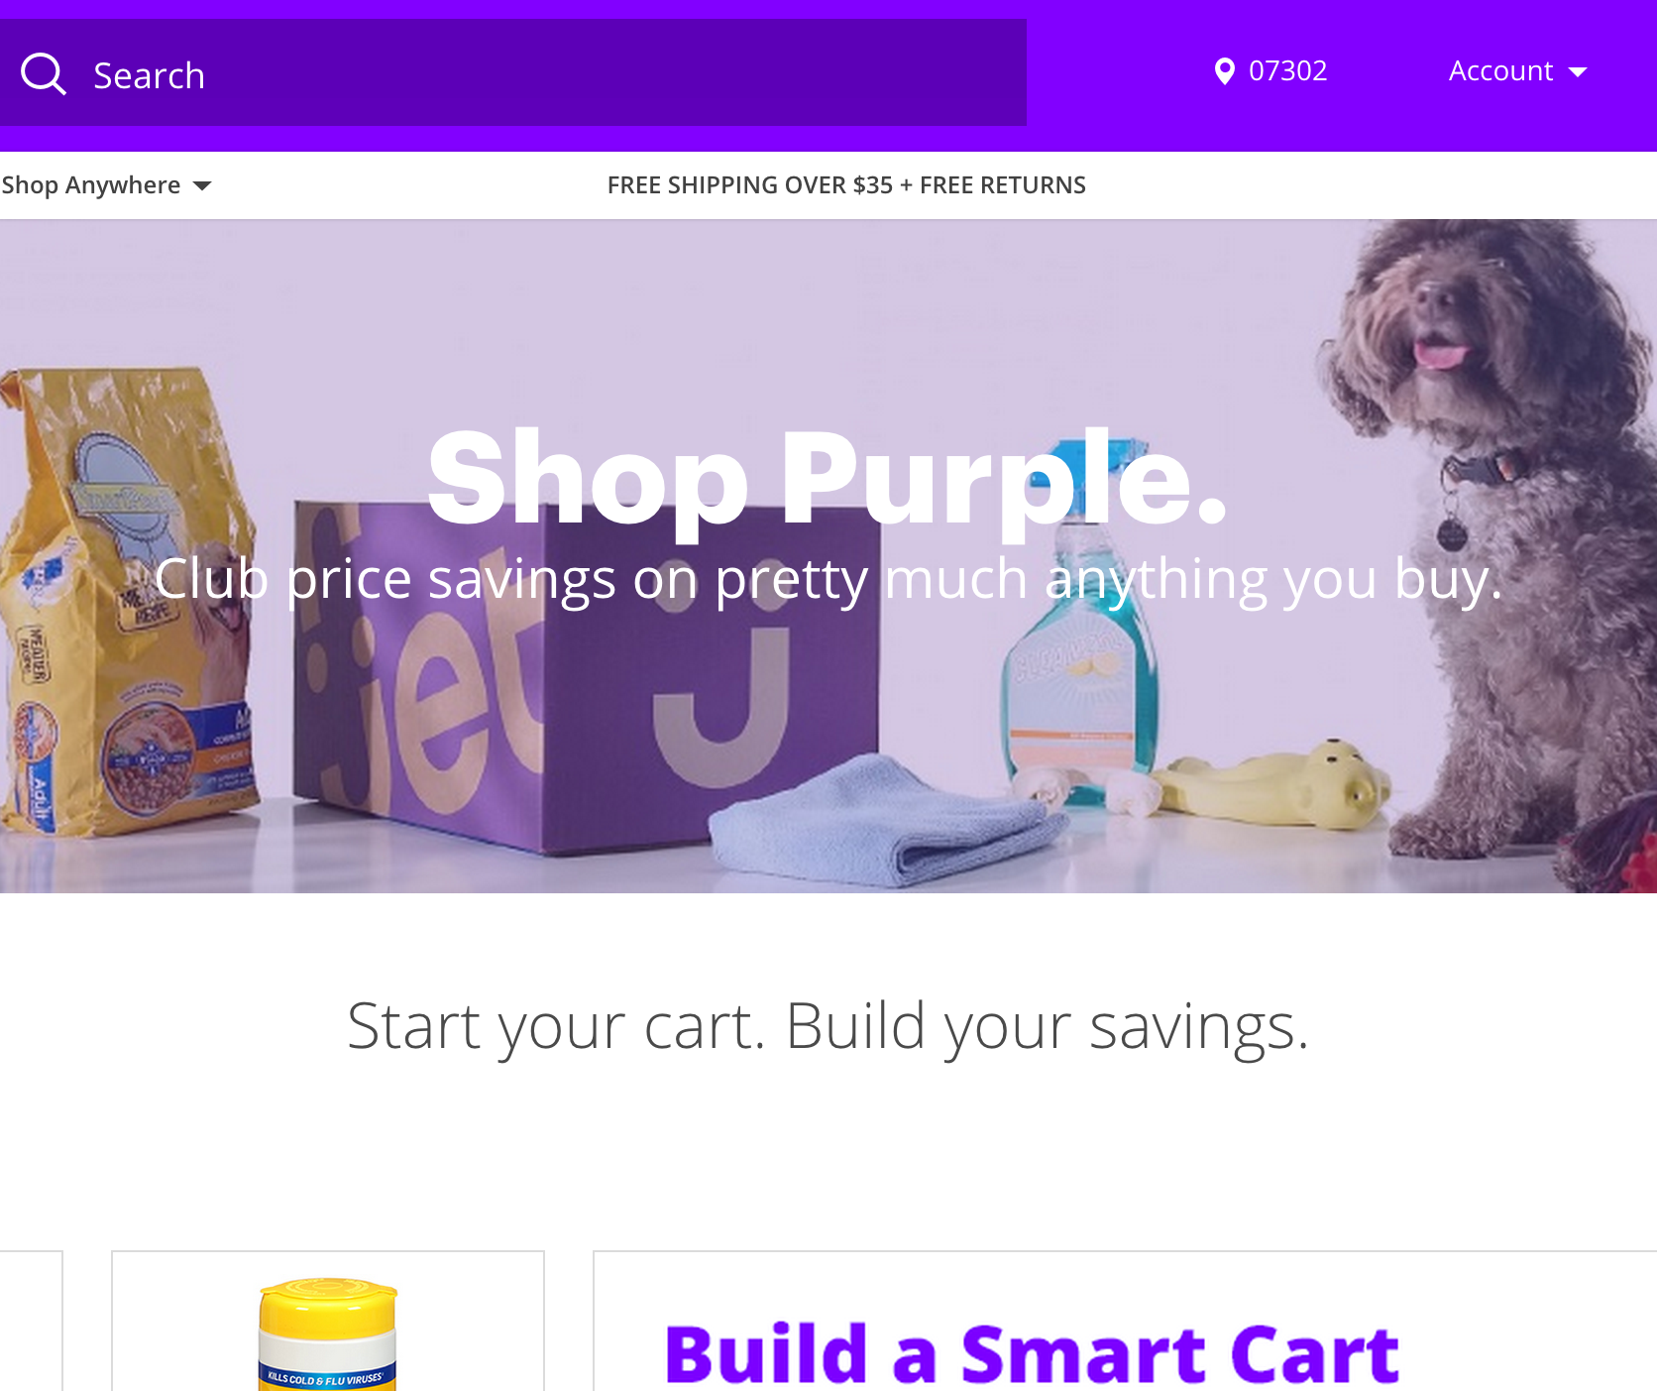

Taking on Amazon!
Launched July 22
Featured: app store & android store
Over 20k orders per day
Over 7 million SKUs
600k first-time buyers
500k mobile downloads
#4 marketplace worldwide
We’re hiring!
http://jet.com/about-us/working-at-jet
Notes:
Exclusively F#
Ahead of Rakutan (Japanese), Sears, bestbuy, newegg…
Behind ebay, amazon, walmart.

Slide 4
Azure
Web sites
Cloud services
VMs
Service bus queues
Services bus topics
Blob storage
Table storage
Queues
Hadoop
DNS
Active directory
SQL Azure
R
F#
Paket
FSharp.Data
Chessie
Unquote
SQLProvider
Python
Deedle
FAKE
FSharp.Async
React
Node
Angular
SAS
Storm
Elastic Search
EventStore
Microservices
Consul
Kafka
PDW
Splunk
Redis
SQL
Puppet
Jenkins
Apache Hive
Apache Tez

Slide 5
Why F#?

Slide 6
Why F#?
Simple code to solve complex problems
Less code
Fewer bugs
Units of measure
Interoperability with .NET
Parallelization
Increased productivity
Type Providers!
Notes:
Simple code -> deceptively simple. Few lines of code to manipulate & graph data.
“If this is what I can do in 10 lines of code, what happens at 10k? Does F# become self-aware?”
Yan Cui – “F# offers us an order of magnitude increase in productivity” at his game dev shop.
Simple means less code means fewer bugs. No need to open 30 files to fix a bug.
Simon Cousin’s blog post. .?
Units of measure -> Xamarin talk. Scientific/Financial/Game programming.
Parallelization -> Specifically last. Very important, but don’t over-emphasize & lose the others.

Slide 7
A brief history

Slide 8
Programming languages evolve just like regular languages.

Slide 9
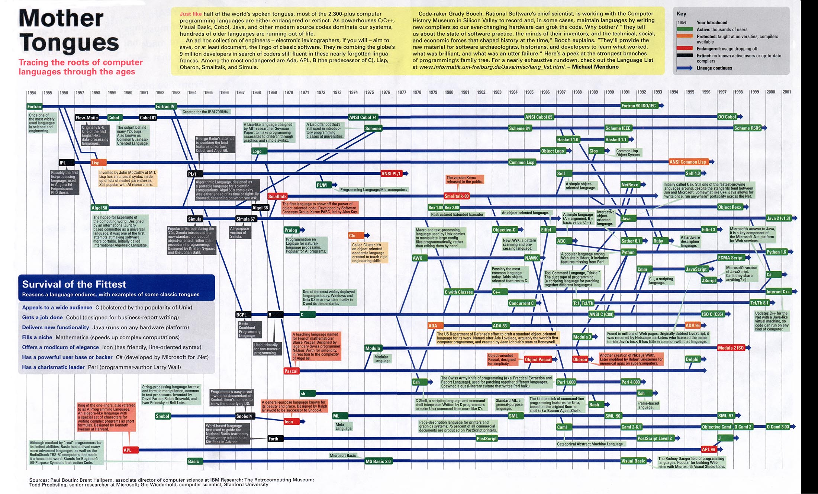
C#
F#

Slide 10
Why F#?
Testimonials

Slide 11
I have now delivered three business critical projects written in F#. I am still waiting for the first bug to come in.
Simon Cousins
UK-based power company
Notes:
Fewer bugs come from less code.

Slide 12
The F# solution offers us an order of magnitude increase in productivity and allows one developer to perform the work [of] a team of dedicated developers…
Yan Cui
Lead server Engineer, Gamesys

Slide 13
The F# code is consistently shorter, easier to read, easier to refactor and contains far fewer bugs.
Kaggle, a predictive modelling company
Notes:
Fewer bugs come from less code.

Slide 14
All of this seems incredible, right?

Slide 15
So why doesn’t everyone use F#?

Slide 16
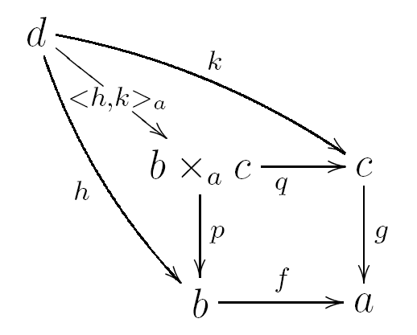

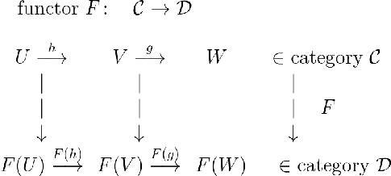
There’s a lot of math behind programming languages like F#.
Notes:
And in some FP communities, people really like to talk about the math.
And how important it is to properly understand it.
Before you can begin to code.

Slide 17
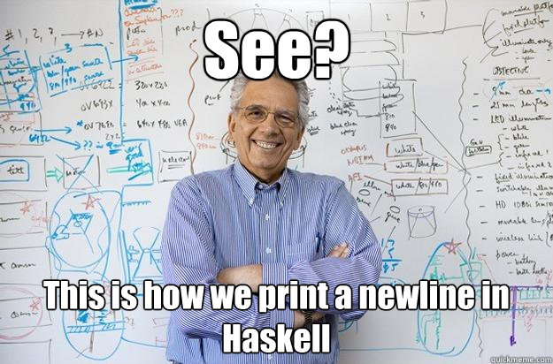

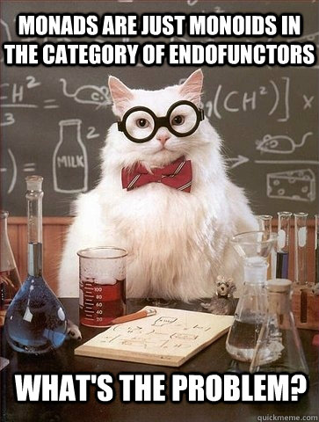
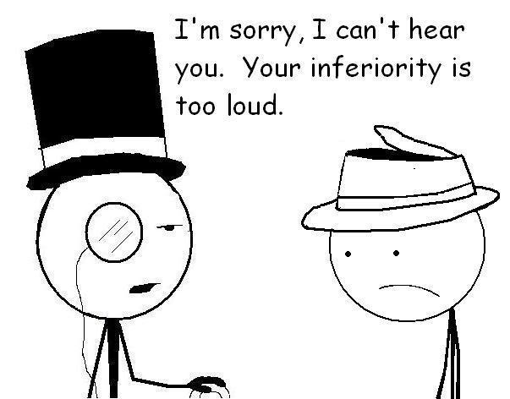

So they have this reputation.

Slide 18

This is Sean.

Slide 19
When Sean was 8, He spoke at a 2000-person technical conference. On F#.

Slide 20
Why F#?
Concise code & expanded feature set

Slide 21
Concise code
C# - 23 lines
F# - 10 lines
open System.Net open System open System.IO let fetchUrl callback url = let req = WebRequest.Create(Uri(url)) use resp = req.GetResponse() use stream = resp.GetResponseStream() use reader = new IO.StreamReader(stream) callback reader url
using System.Net using System using System.IO class WebPageDownloader { public TResult FetchUrl<TResult>( Func<string, StreamReader, TResult> callback, string url) { var req = WebRequest.Create(url); using (var resp = req.GetResponse()) { using (var stream = resp.GetResponseStream())
{ using (var reader = new StreamReader(stream)) { return callback(url, reader); } } } } }
From Comparing F# with C#, fsharpforfunandprofit.com
Notes:
Let’s see an example.
From fsharpforfunandprofit.com

Slide 22
Concise and powerful code
Same info as C#!
C#
F#
public abstract class Transport{ } public abstract class Car : Transport { public string Make { get; private set; } public string Model { get; private set; } public Car (string make, string model) { this.Make = make; this.Model = model; } } public abstract class Bus : Transport { public int Route { get; private set; } public Bus (int route) { this.Route = route; } } public class Bicycle: Transport { public Bicycle() { } }
type Transport = | Car of Make:string * Model:string | Bus of Route:int | Bicycle
Trivial to pattern match on!
Notes:
Option type is a simple discriminated union.
Both are idiomatic.
C# version still lacks structural equality (based on contents): that means overriding the equality implementation, the comparison implementation, AND GetHashCode. (generates a hash code from your object instance).
Also not proper immutability because private set is still mutable. To get real immutability, there should be no setter, and the backing field should be readonly.
Pattern matching is like a switch statement, but WAY more powerful.

Slide 23
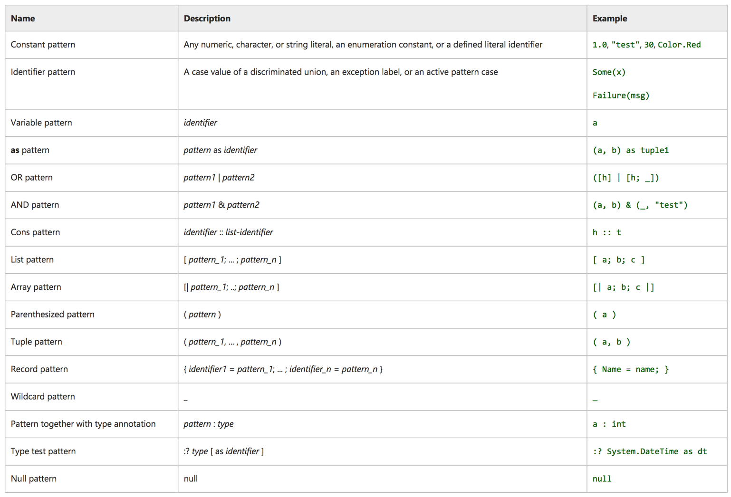
C#
F# pattern matching

Slide 24
Concise and powerful code
C#
F#
public abstract class Transport{ } public abstract class Car : Transport { public string Make { get; private set; } public string Model { get; private set; } public Car (string make, string model) { this.Make = make; this.Model = model; } } public abstract class Bus : Transport { public int Route { get; private set; } public Bus (int route) { this.Route = route; } } public class Bicycle: Transport { public Bicycle() { } }
type Transport = | Car of Make:string * Model:string | Bus of Route:int | Bicycle
let getThereVia (transport:Transport) = match transport with | Car (make,model) -> ... | Bus route -> ...
Warning FS0025: Incomplete pattern matches on this expression. For example, the value 'Bicycle' may indicate a case not covered by the pattern(s)
Notes:
Option type is a simple discriminated union.
Both are idiomatic.
C# version still lacks structural equality (based on contents): that means overriding the equality implementation, the comparison implementation, AND GetHashCode. (generates a hash code from your object instance).
Also not proper immutability because private set is still mutable. To get real immutability, there should be no setter, and the backing field should be readonly.
Pattern matching is like a switch statement, but WAY more powerful.

Slide 25
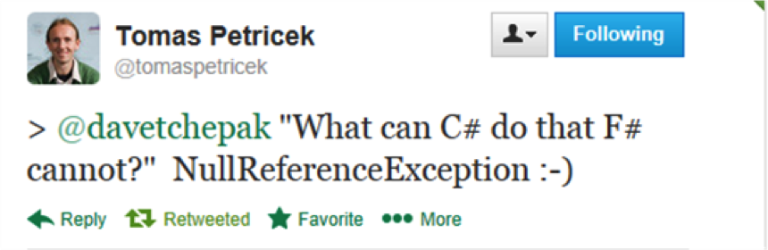
Expanded feature set: Option types
Notes:
NullReferenceException can be obviated because of option types.
Similar to nullable<int> but different because:
Can be used on any type (strings, functions)
When pattern matched on, forces you to consider None case
Can use map, iter, etc. functions.
Nestable: Option<Option<int>> is valid.

Slide 26
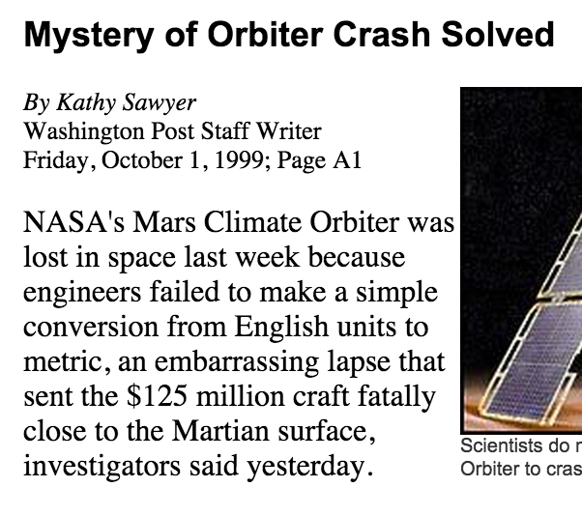
Units of Measure

Slide 27
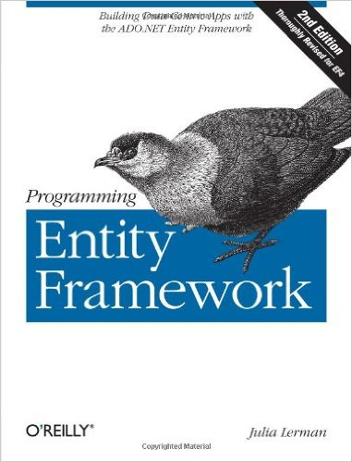
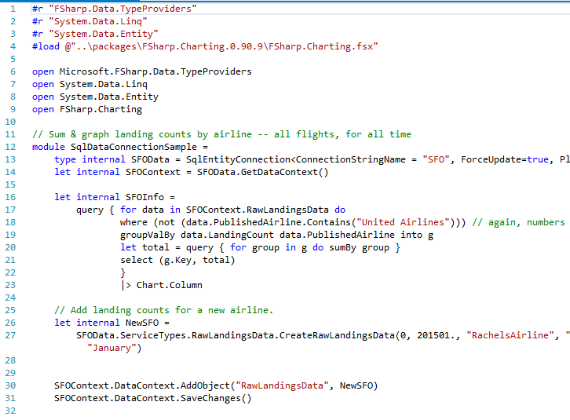
Expanded feature set: Type providers
920 pages!
31 lines!

Slide 28
Why F#?
Dependencies
Notes:
Let’s back up a minute.

Slide 29
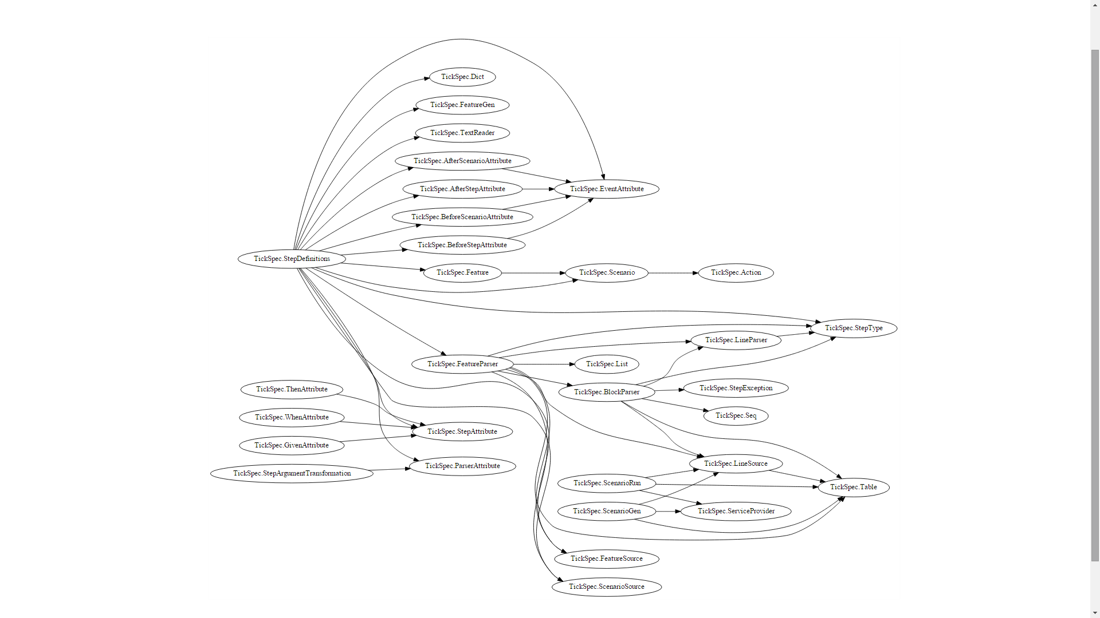
TickSpec – an F# project
Thanks to Scott Wlaschin for his post, Cycles and modularity in the wild
Notes:
E.g.: TickSpec: StepDefinitions depends on TickSpec: Feature

Slide 30
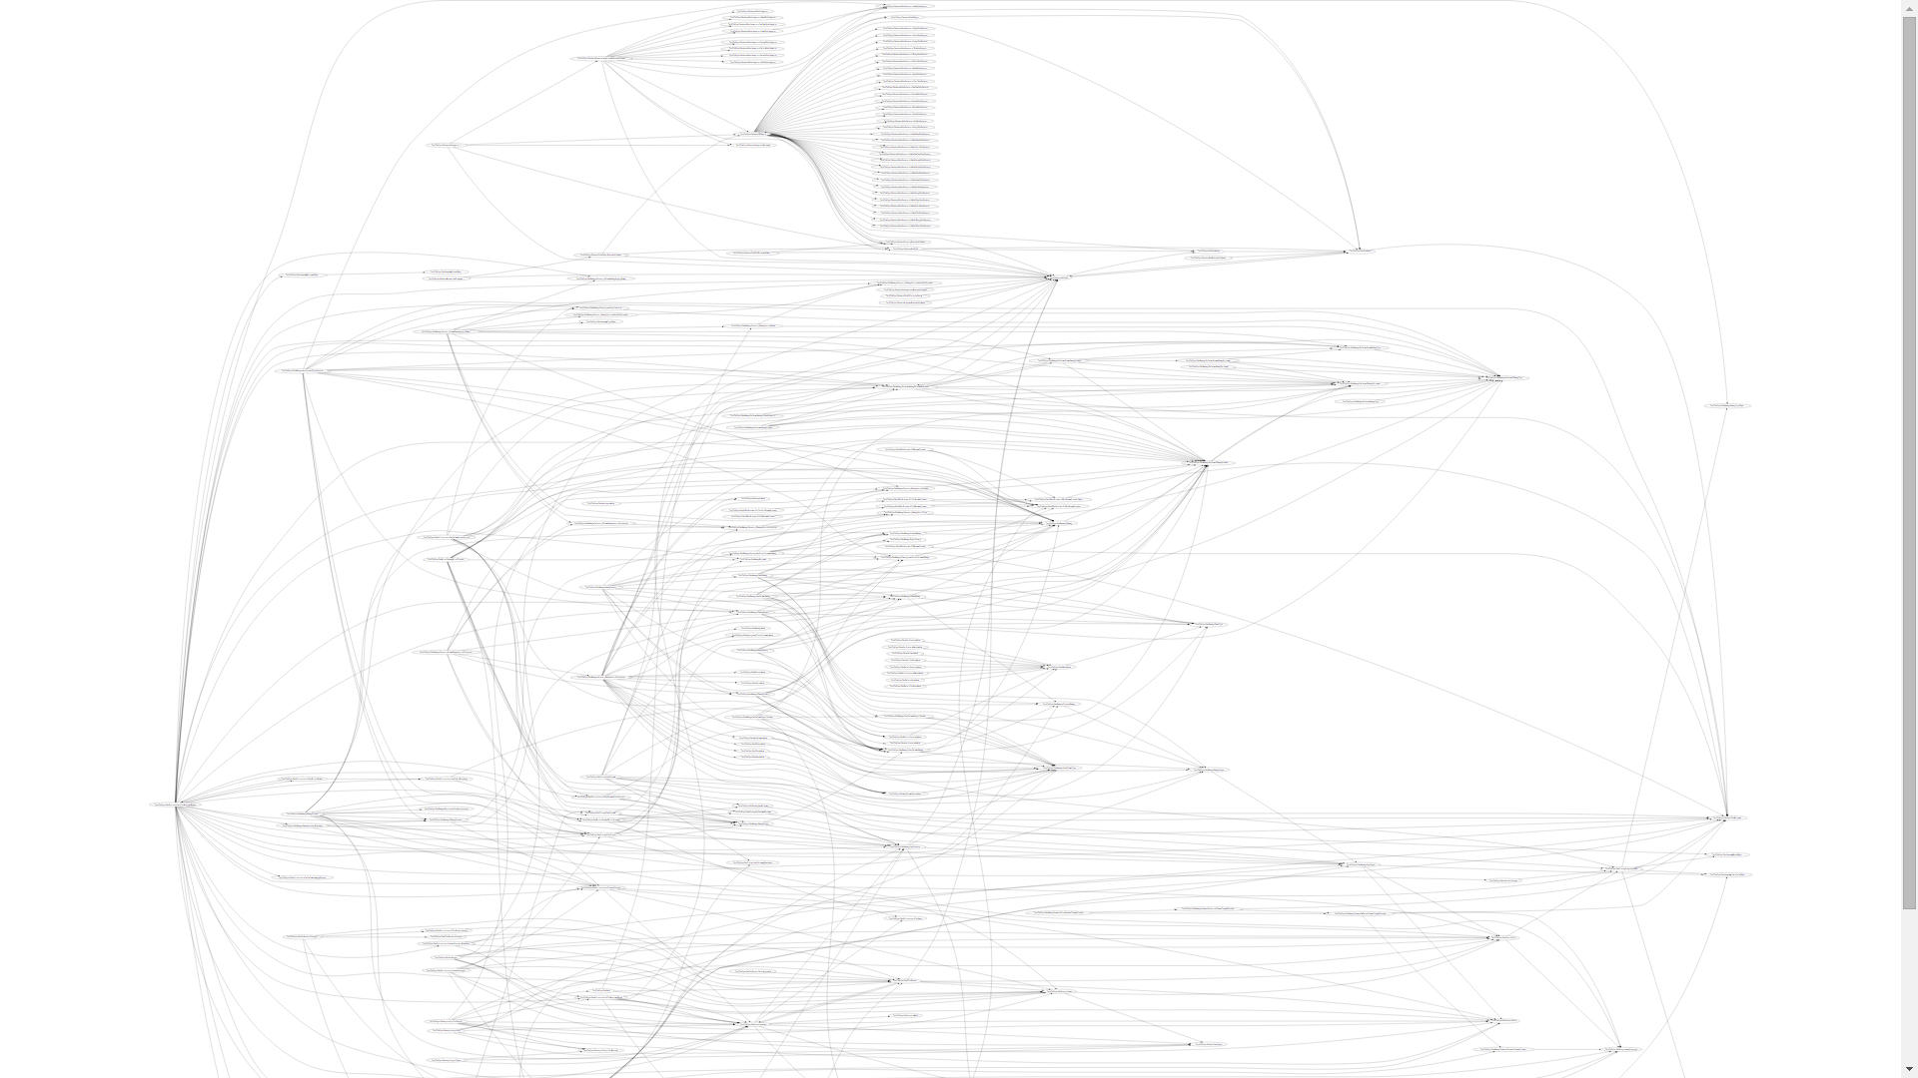
SpecFlow– a comparable C# project
Thanks to Scott Wlaschin for his post, Cycles and modularity in the wild

Slide 31

Entity Framework (C#)
Thanks to Scott Wlaschin for his post, Cycles and modularity in the wild

Slide 32
Using Type Providers

Slide 33

What are type providers?
A mechanism to provide types to the compiler.
Notes:
A compiler plug in.
Get typed data into your code at design time. → Excel, csv, wsdl, xaml, sql server.
Good way to bring in other languages to F#. → Python, R, Matlab.

Slide 34

Why do we need type providers?
Because data!
Notes:
World is information-rich! Exploration is fun! Big data!
Data has a form to it, a schema. Losing that while you’re playing around is :(

Slide 35


Why do we need type providers?
Obtain data
Create infrastructure
Actually consume data
Set up connection
Because current data consumption methods.
Notes:
Type providers are literally 1-2 lines of set up.

Slide 36
Why do we need type providers?
More natural with REPL
Intellisense, tooltips, & other tooling available
Scalable to millions of types (e.g. – world bank)
No extra bloated code
Always in sync with the source
No code generation
Simplicity
Elegance
Tooling
Notes:
REPL -> Discovery.
No Code Gen -> EF
EF type provider generates all the EF files, but does the generation in memory, then merges the resultant IL into your code, and cleans up after itself. No need to maintain all the EF leftover files.

Slide 37

Demos.
WSDL Mash-up
SQLDataConnection
SQLEntityConnection
Powershell
World Bank/R Mash-up
XAML
Notes:
https://github.com/fsprojects/FSharp.TypeProviders.StarterPack

Slide 38
Some Existing Type Providers.
Powershell
Azure
Choose your own adventure
Matlab
RSS
DBML
R
MS Dynamics CRM
World Bank
CSV
JSON
XML
LINQ
XAML
WSDL
SQL Server with EF
Python
OData
Apiary
Facebook
EDMX
SignalR
Hadoop
IKVM
FunScript
Regex
Don Syme
SQLite
Squirrels
Minesweeper
MVVMCross
Rock, Paper, Scissors
Oracle
SQL Server
File System
Dates
COM
FizzBuzz
Amazon S3
Freebase
Sqlite
Azure

Slide 39
GET creative.
Get data from
Hadoop
SQL Server
RSS
CSV
OData
World Bank
JSON
Process with
Matlab
R
Powershell
Python
SignalR
R
Matlab
Visualize with
Regex
LINQ
F#

Slide 40
Writing your own Type Provider
ALL YOUR TYPES ARE BELONG TO US

Slide 41
Two questions before you write your own!
How frequently will you use the type provider?
How stable is the information source’s schema?
Notes:
Just implementing an interface → like implementing a query provider for linq.
Serious bit of code. If just a one-off, don’t do it.
Stable at runtime is recommended.

Slide 42
Demo
Developing and connecting to a homegrown type provider

Slide 43
Consuming Data with F# Type Providers
TYPE ALL THE DATA
@rachelreese | rachelree.se | github.com/rachelreese

